Slide 1
COMP 3500 Introduction to Operating Systems Project 4 – Processes and System Calls Part 1: Overview
Dr. Xiao Qin
Auburn University http://www.eng.auburn.edu/~xqin
xqin@auburn.edu
Notes:
Fall’17: Project 4 is partitioned into projects 4 and 5. Overview is scheduled on 09b. Minutes:
Fall’16 Scheduled changed. 09a is now 08a. We are one lecture ahead of the schedule. Plan to add Lecture17-device management (see also 17-Device Management-Not Covered.pptx)
Fall’15: Cont. Lec08c-Deadlock Detection Slides 15-19
40 Minuets:

Slide 2
Project 4
Processes and System Calls

Slide 3
Project Objectives
To collaborate with your group members using CVS/git/Github
To start building a multi-tasking operating system
To develop system calls to manage processes
To develop system calls to manage file system states
Use GDB to debug OS/161
2 Weeks to achieve the above objectives!
Notes:
6 Weeks -> 3 Weeks (part 1).

Slide 4
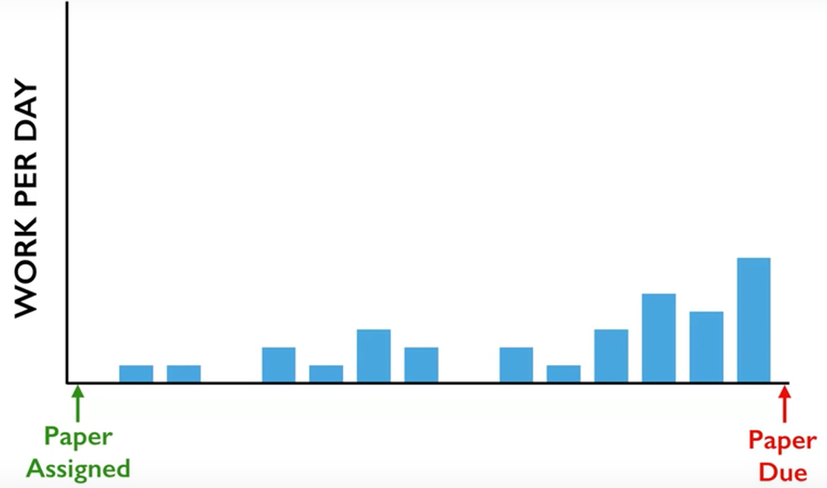
Reference: Inside the mind of a master procrastinator | Tim Urban
https://www.youtube.com/watch?v=arj7oStGLkU

Slide 5
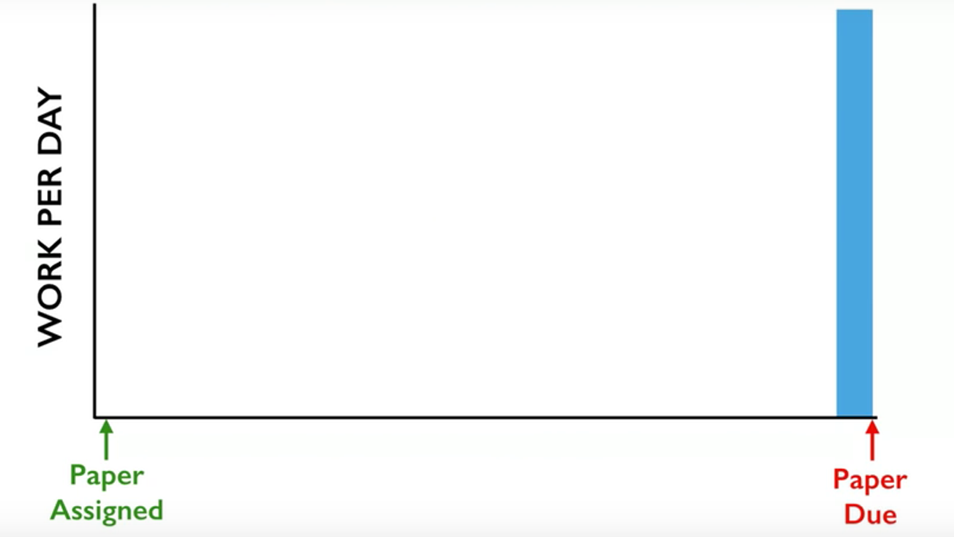

Slide 6
What are available on Canvas?
Project description
FAQs
Instructions on adding system calls
Sample source code
getpid_syscall.c,
getpidtest.c,
sample_file.h,
sample_runprogram.c, and
sample_thread.h.

Slide 7
Three Tasks: Due on Nov. 3
Task 1: Code Reading
Individual
Task 2: Design
Discussion / Collaboration
Task 3: Programming
Collaboration

Slide 8
Three Sub-tasks of Tasks 3:
Task 3.1:
getpid
fork, execv, waitpid, _exit
Task 3.2:
open(const char *path, int oflag, mode_t mode)
read(int fd, void *buf, size_t nbytes)
write(int fd, const void *buf, size_t nbytes)
Task 3.3:
lseek(int fd, off_t offset, int whence)
close(int fd)
dup2(int oldfd, int newfd)
Project 4
Project 5

Slide 9
3-Minutue Group Discussion on Time Management How many days for each task? What are the deadlines of the tasks? Who will be working on tasks 3.1-3.3?
Task 1: Code Reading
Task 2: Design
Task 3:
Task 3.1: fork
Task 3.2: execv
Task 3.3: waitpid, _exit
This project is due on Nov. 3, Friday at 11:59PM.
Notes:
Due on Nov. 11

Slide 10
Three Tasks: Due on March 24
Task 1: Code Reading
Individual; Soft Deadline: Oct. 22 (2 Days)
Task 2: Design
Collaboration; Soft Deadline: Oct. 24 (5 Days)
Task 3: Programming
Discussion; Hard Deadline: Nov. 3 (7 Days)
Notes:
Due on March 24
Task 1: Code Reading
Individual; Soft Deadline: March 10 (3 Days)
Task 2: Design
Collaboration; Soft Deadline: March 15 (5 Days)
Task 3: Programming
Discussion; Hard Deadline: March 24 (9 Days)
Due on Nov. 11
Task 1: Code Reading
Individual; Soft Deadline: Oct. 8 (6 Days)
Task 2: Design
Collaboration; Soft Deadline: Oct. 18 (10 Days)
Task 3: Programming
Discussion; Hard Deadline: Nov. 11 (24 Days)

Slide 11
Collaboration is Important!
Please evenly distribute the programming tasks among the three group members.
Unbalanced programming load among the members is likely to lead to a development delay of this project.

Slide 12
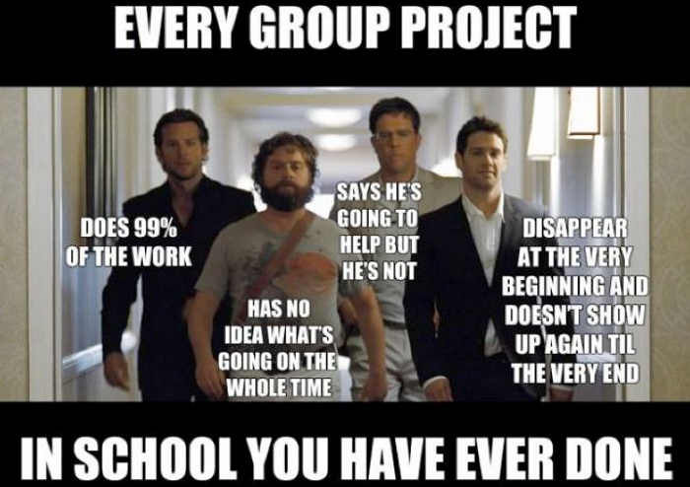
Notes:
Not all groups are perfect.
You can meet some who do not care about their grades, or simply do not know what to do.

Slide 13
What’s New? A Collaboration Report
To evaluate each individual member’s contributions to the project
Your collaboration report must contain:
What are contributions from each individual member?
How did your group members collaborate on this project?
Did you have a plan and work to it? Did the group stick to the plan? If not, why not?
What would you do differently next time?

Slide 14
How to collaborate?
Naming global variables
A consistent way of writing function and variable names
How often to commit changes to CVS?
Ensure a working version from CVS

Slide 15
Partnership
To manage your partnership
If you and your group members have difficulty working together, please talk with the TA or Dr. Qin
We will help your partnership work more effectively

Slide 16
Before add a file to CVS …
chmod 640 or chmod 644
A word about permissions:
0 = no operations allowed
1 = execute permission or the ability to cd in the case of a directory
2 = write permission
4 = read permission
Default value 711
Owner, Group Members, non-group members
Notes:
Your home directory will have permissions 711 by default. These permissions mean the following: 7 = 4+2+1:You (the owner) can read/write/execute 1 = 1:Other users in your group can cd/execute but not read or write 1 = 1:Other users not in your group can cd/execute but not read or write

Slide 17
To Build a Real Multi-tasking Operating System
In project 3, Cats-Mice program:
Functions linked into the kernel
Run inside the kernel
Reason? unable to run user-space code
Goal: Make OS/161 run user-space programs
Notes:
Your home directory will have permissions 711 by default. These permissions mean the following: 7 = 4+2+1:You (the owner) can read/write/execute 1 = 1:Other users in your group can cd/execute but not read or write 1 = 1:Other users not in your group can cd/execute but not read or write

Slide 18
Current Version
Reboot is the only working system call available to user-space code
The kernel does NOT understand what a process is
The kernel does NOT maintain any per-process state
Ninimal support for running executables
Objectives: Solve the above problems
Notes:
Your home directory will have permissions 711 by default. These permissions mean the following: 7 = 4+2+1:You (the owner) can read/write/execute 1 = 1:Other users in your group can cd/execute but not read or write 1 = 1:Other users not in your group can cd/execute but not read or write

Slide 19
Project 4 is a foundation for Project 5
OS/161 will to run multiple processes simultaneously from actual compiled programs
Programs will be loaded into your OS/161
Programs will be executed in user mode by the System/161.
Be controlled by your kernel and the command shell in bin/sh
Notes:
you have to implement the interface between user-mode programs ("userland") and the kernel. You will be provided part of the code needed for this assignment, and you are required to design and implement the missing pieces. Your job also includes implementation of the subsystem that keeps track of the multiple tasks you will have in the future. Importantly, you need to design data structures for "process" (Hint: look at kernel include files of your favorite operating system for suggestions,

Slide 20
System Calls
To implement an interface between user programs and the kernel
System Calls
Notes:
you have to implement the interface between user-mode programs ("userland") and the kernel. You will be provided part of the code needed for this assignment, and you are required to design and implement the missing pieces. Your job also includes implementation of the subsystem that keeps track of the multiple tasks you will have in the future. Importantly, you need to design data structures for "process" (Hint: look at kernel include files of your favorite operating system for suggestions,

Slide 21
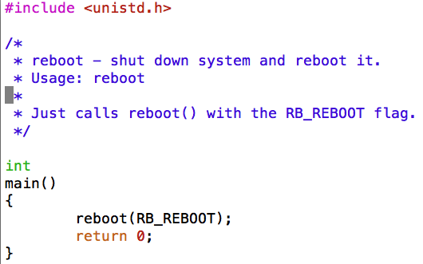
How does a user program work?
Existing User Programs
~/cs161/src/sbin
Reboot, halt, poweroff
Notes:
you have to implement the interface between user-mode programs ("userland") and the kernel. You will be provided part of the code needed for this assignment, and you are required to design and implement the missing pieces. Your job also includes implementation of the subsystem that keeps track of the multiple tasks you will have in the future. Importantly, you need to design data structures for "process" (Hint: look at kernel include files of your favorite operating system for suggestions,

Slide 22
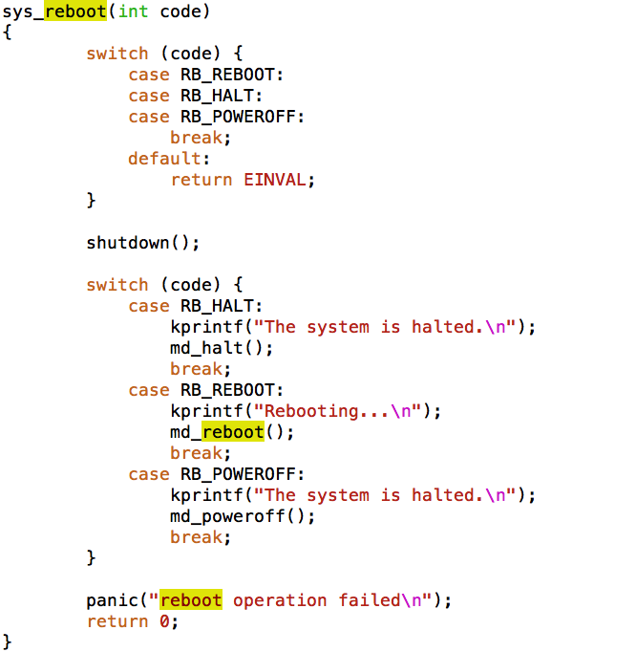
More about reboot
~/cs161/src/kern/main/main.c

Slide 23
How to run a user program?
Run normal programs compiled from C on the System/161 simulator
cs161-gcc
Notes:
you have to implement the interface between user-mode programs ("userland") and the kernel. You will be provided part of the code needed for this assignment, and you are required to design and implement the missing pieces. Your job also includes implementation of the subsystem that keeps track of the multiple tasks you will have in the future. Importantly, you need to design data structures for "process" (Hint: look at kernel include files of your favorite operating system for suggestions,

Slide 24
Task 1: Read Source Code
You do not need to submit your answers to these questions
You must make an effort to answer them.

Slide 25
Task 1: Read Source Code
kern/userprog: the user program
loadelf.c, runprogram.c, anduio.c
kern/arch/mips/mips: traps and syscalls
syscall.c: handles traps that happen to be syscalls
~/cs161/src/lib/crt0: user program startup
It invokes the user program's main()
Notes:
MPIS control executions

Slide 26
Task 2: Design Your Project
Who will be responsible for which parts of your implementation?
(Document your discussion in the collaboration report)
Data structures
Global and local variables
Algorithms for the system calls

Slide 27
Task 2: Sample Design Questions
What data structures will you need to manage multiple processes?
What relationships do your new data structures have with the OS/161?
How will you manage file accesses?
When the shell invokes the cat command, and cat starts to read file1, what will happen if another program also tries to read file1?
What would you like to happen?

Slide 28
Task 3: Implementing System Calls
getpid
I will show you how to implement this system call)
fork, execv, waitpid, _exit
open, read, write, lseek, close, dup2
Project 4
Project 5

Slide 29
Project 5: System Calls
open(const char *path, int oflag, mode_t mode): It should be as simple as it seems.
read(int fd, void *buf, size_t nbytes): You can use struct uios, and make use you understand it. You also can check out VOP_READ.
write(int fd, const void *buf, size_t nbytes): Involves I/O to userland. You can use struct uios again. Please check out VOP_WRITE.

Slide 30
Project 5: System Calls
lseek(int fd, off_t offset, int whence): Can we always perform an lseek? For example, can we perform lseek() beyond the end of a file? Please use VOP_TRYSEEK.
close(int fd): It may be interesting because of the refcounting issue (think about garbage collection)!
dup2(int oldfd, int newfd): If newfd is already opened, close it. Upon successful completion, both file descriptors refer to the same file table object and share all properties of the object.

